Slide 1
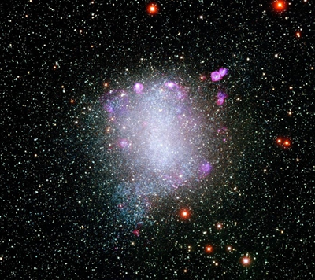
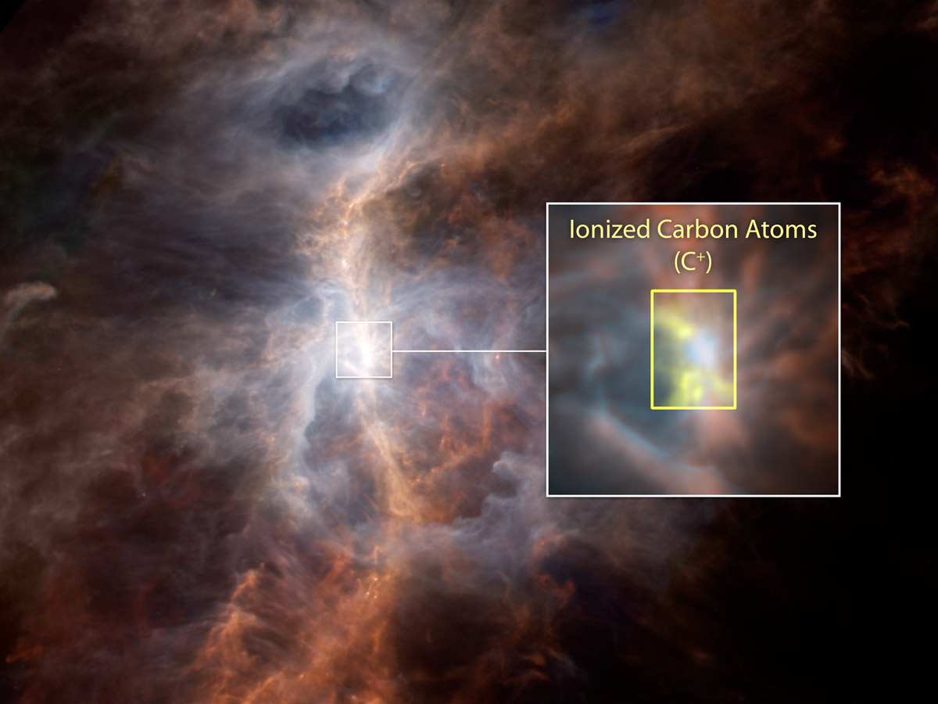
Mapping Cooling of Interstellar Atomic Gas with CII Emission Spectroscopy
Credit: Local Group Galaxies Survey Team/NOAO/AURA/ NSF.
Emily Apel, Rhonda Holton, Paul Scowen
Credit: NASA
Notes:
Barrion cycle - high mass stars important af
Get bullet points on what you wanna get across

Slide 2
Overall Goals
Relate slope of Initial Mass Function (IMF) to cooling of atomic gas in local, low-metallicity dwarf galaxies
Use low-metallicity dwarf galaxies as a proxy to characterize early universe star formation
Notes:
Overall goals of the project as a whole blah blah
Write out initial mass function

Slide 3
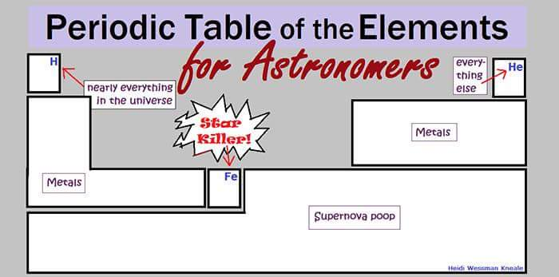
First of all, what is metallicity?
Oxygen
Low Threshold: 8.0
0.01% Solar
Notes:
Remove H and He boxes and add carat above table that says low metallicity
Redo table~ put log with O/H
Add compare to solar - maybe add percent of solar metallicity column
Solar metallicity is ~9.6 - more than an order of magnitude less
Explain metallicity FIRST!!!!!!!!!!!
***add column comparing to percentage of solar

Slide 4
Where are we looking?
Target | Oxygen Metallicity | % Co
Sextans A | 7.5 ± 0.1 | 0.013%
WLM | 7.8 ± 0.1 | 0.0063%
Barnard’s Galaxy | 8.1 ± 0.2 | 0.0158%
NGC 4214 | 8.2 ± 0.1 | 0.00316%
Threshold: 8.0
0.01% Solar

Slide 5
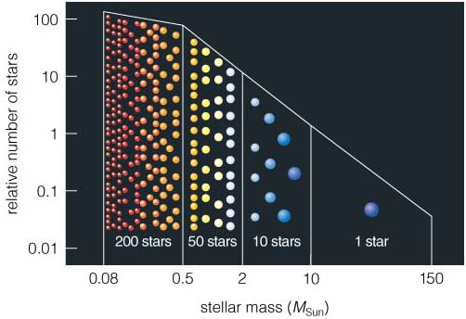
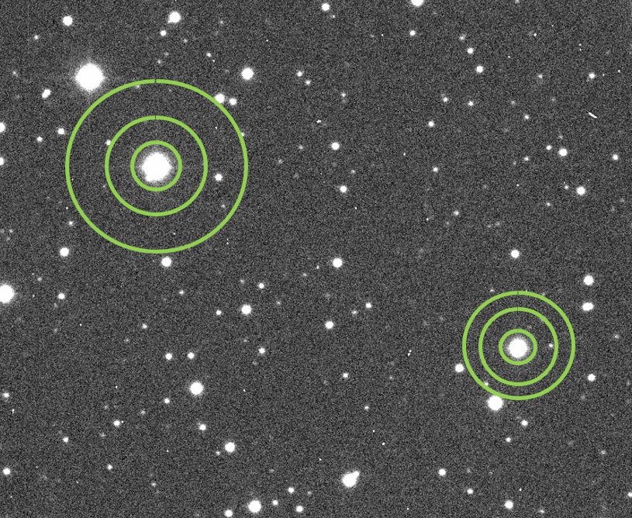
What is IMF?
~ -2.0 (Salpeter Value)
Expectation
Credit: University of Colorado Boulder
Notes:
So before getting into everything we’re doing right now, I’d like to quickly go over some things we did last year and we are still doing right now that relate to the overall goals. First most important is IMF. What the f is that? Well IMF stands for the initial mass function and basically, it’s the mass distribution of stars in a star-forming region. So when the IMF is measured, different masses of stars are thrown into quasi bins as shown in this wonderful graph that I found. So on the x axis we have stellar mass and on the y we have number of stars. So depending on the mass of the star, it gets placed somewhere along this graph. High mass, low mass, mid mass, etc. The way it’s shown rn, this graph shows the general IMF we see in today’s universe, which is an IMF skewed towards lower mass stars. High mass stars are not super common, and we see lots of lower mass stars. The actual value of this IMF, is the slope of this line. It’s about -2.0 and we call it the Salpeter value. In the early universe, however, (remember this is our main goal, characterizing the early universe), we expect an IMF skewed towards higher masses, and this is because back then there were only “non-metals” like hydrogen and helium present (should I go more into this?? Or is there not enough time??) To do this portion of the work, we are using aperture photometry to measure IMF.
We are measuring the brightness of the stars → which will relate to the mass of the stars (using aperture photometry)

Slide 6

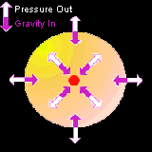
Why cooling?
Credit: WorldArtsMe
Gravity must win here!
How do stars form?
Thermal Pressure removed via cooling OR
More material and thus more mass and gravity
Credit: NASA
Credit: Local Group Galaxies Survey Team/NOAO/AURA/ NSF.
Notes:
From here on, I will be talking about things I’ve learned and done this year
Talk about right side first!
Change nebula picture to cartoon picture of cloud
What we’ve already done:
Analyze IMF of local, low-metallicity dwarf galaxies to characterize star forming regions of the early universe
Done with stellar flux measurements using aperture photometry
Next piece → map cooling
Next Goals:
Analyze abundance of ionized Carbon (CII) (also OI) in our targets
From CII (and OI) abundances, we can map cooling of atomic gas in star forming regions
We then hope to relate these abundances to measurements of IMF in our targets and characterize early universe star formation
So a lot of this doesn’t make much sense if you don’t know what it is, so let’s break it down~

Slide 7
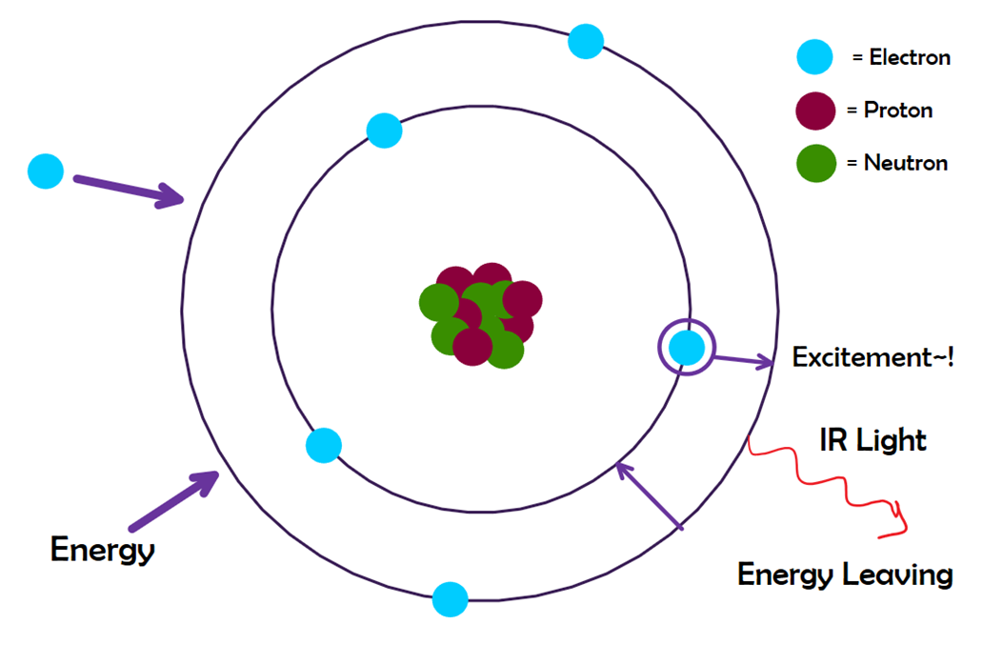
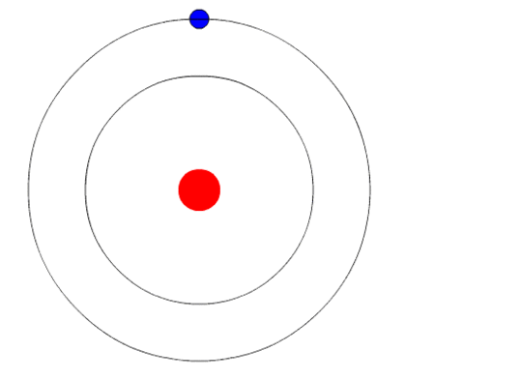
How does cooling occur?
CII (C+) → Carbon which has been ionized once
Excitation of C+ causes energy to leave → cooling
Credit: Physics Stack Exchange
CII Orbital Model
Notes:
CII cools well at all densities
So why does the abundance of ionized carbon help us map cooling of atomic gas?
Every atom has protons and neutrons in the nucleus and then electrons surrounding it in atomic orbitals. Generally, depending on the element, these orbitals take on various different shapes depending on the type of orbital, but the general model to represent energy levels of these electrons looks like this. For ionized carbon, which is carbon that has been ionized once from radiation in the universe, this is the energy level model of the atom - same as a normal carbon atom, just minus one electron. In these stellar forming regions, which are filled with molecular gas, particles are moving around and thus bumping into each other all the time. That movement of particles is what gives us temperature - measurement of kinetic energy i.e. movement of particles. This means that the less kinetic energy, the lower the temperature. So in this environment where particles are moving around and bumping into each other, ionized carbon that is present in this region will readily allow cooling to occur through the process shown in this diagram - the excitement of an electron when energy is put in. As particles, specifically electrons, bump into ionized carbon atoms, those electrons cause an energy change and will cause an electron in the atom to move up an energy level - excited electron. However, because the general trend of all atoms and molecules in the universe is to retain the lowest energy state possible, that excited electron wants to move back down to its original energy state and when it does that, the energy initially gained will be released as infrared light. When energy is lost, the temperature will be lower. Thus, this loss of energy results in cooling (since decrease in energy = decrease in temperature). So we want to measure how much this is happening in these environments - how much of this gas is being cooled by CII.
IR light has longer wavelength than light like say UV light and longer wavelengths can move through and out of the cloud more easily. Ideally radio, but radio emissions not helpful for cooling.
Factors for why Carbon is useful for cooling:
Abundance - carbon and oxygen are very abundant in the universe - Oxygen then Carbon after H and He - this process is common, so it’s easy for us to measure
Cooling rate → carbon transitions and therefore energy release (cooling) can happen at much lower densities, which is why using carbon is the most useful. Oxygen does not do this until much higher densities, which only exist primarily right around high mass stars.
How easily energy can leave

Slide 8
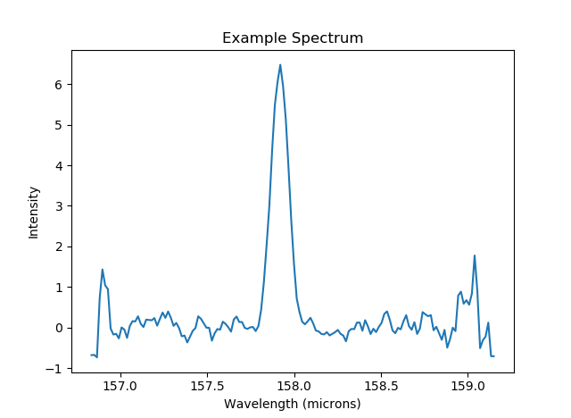
How are we measuring it?
Flux is the area under the curve.
Baseline
Notes:
If no data, add horizontal axis with numbers
Heat map images
Thing I did: retrieving data from archive
Make a timeline from August until now~ EVERYTHING
But how do we measure it?
Well, as I said earlier, the energy that leaves each of those individual ionized carbon atoms leaves as infrared light - that light is emitted i.e. we can collect an emission spectrum from the gas and see how much ionized carbon emission is taking place to determine how much cooling is occuring. When we collect a spectrum, this is generally how it will look. You will have a peak emitted at a certain frequency and the area under that peak will tell us how much ionized carbon underwent this cooling process. To do this, we first need to determine this baseline and from that baseline we then need to determine how to find the area and thus the amount of CII.
Starting from a certain, determined baseline, we will measure the area under the curve to determine how much this release of energy - how much this cooling - occurs.
Change amount of cii to amount of cooling
Fit gaussian to data → where we will start trying to find the area under the curve

Slide 9
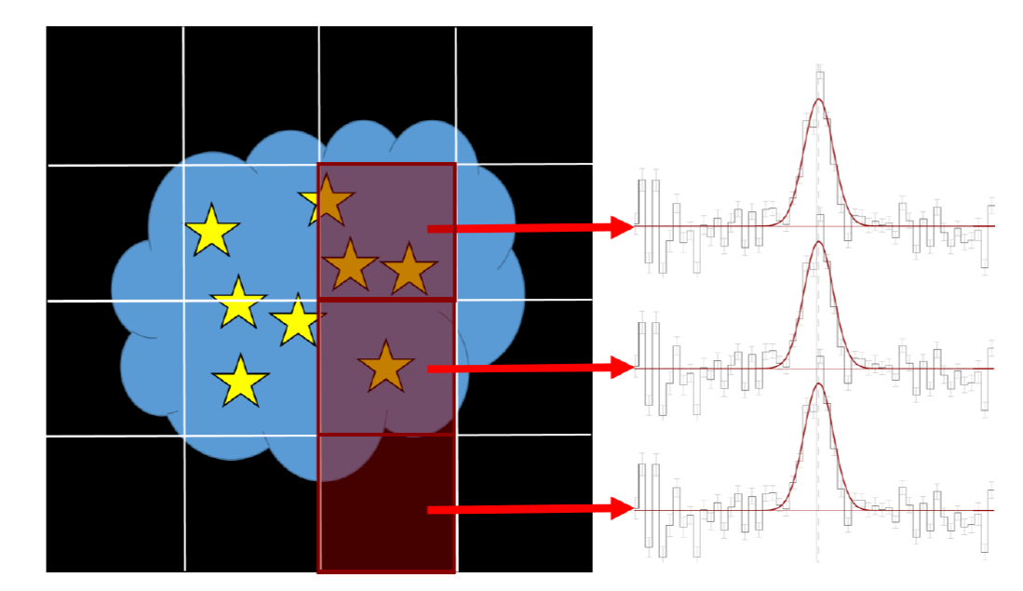

Slide 10
Importance of Results
This year, we developed a method for measuring cooling of atomic gas in our targets using spectroscopy.
Next we will relate cooling to IMF in our target galaxies.
We predict regions with less cooling will have more high mass stars and vice versa.
Notes:
*import slides from last talk to relate IMF information and background info

Slide 11
Acknowledgements
Paul Scowen
Rhonda Holton
Karen Knierman
Jackie Monkiewicz
ASU/NASA Space Grant

Slide 12
Questions?

